Slide 1
GROUP 1: SOLUTION TO PROBLEM 1
PARTICIPANTS:
Sammy Kabingu.
Joseph Njoroge.
Joseph Muturi.
Brian kimemia.

Slide 2
PROBLEM STATEMENT
Implementing effective transition from different Statutory institutions(SI) .
Remand homes
Rehabilitation schools
Classifications and assesement centers
Rescue centers

Slide 3
GOALS/OBJECTIVES
To design a module and define the different (SI) institutions within the CPIMS system that will enable smooth and efficient transition of children across the different statutory institution (SI) by minimizing the data entry process and at the same time making sure all the relevant data has been captured.

Slide 4
IMPLEMENTATION FORMS
Biodata collection
Pre-admission
Admission
Stay
Pre-exit
Exit
Reintegration

Slide 5
SOLUTION METHODOLOGY
Utilize cpims existing technologies eg Data Forms through inheritance .
Generate forms .
Define common form attributes used in the different institution forms.
Abstract form functionalities with respect to the different institutions forms needs.
Create templates forms and views for the forms.
Connect the forms to the database and derive the CRUD logic

Slide 6
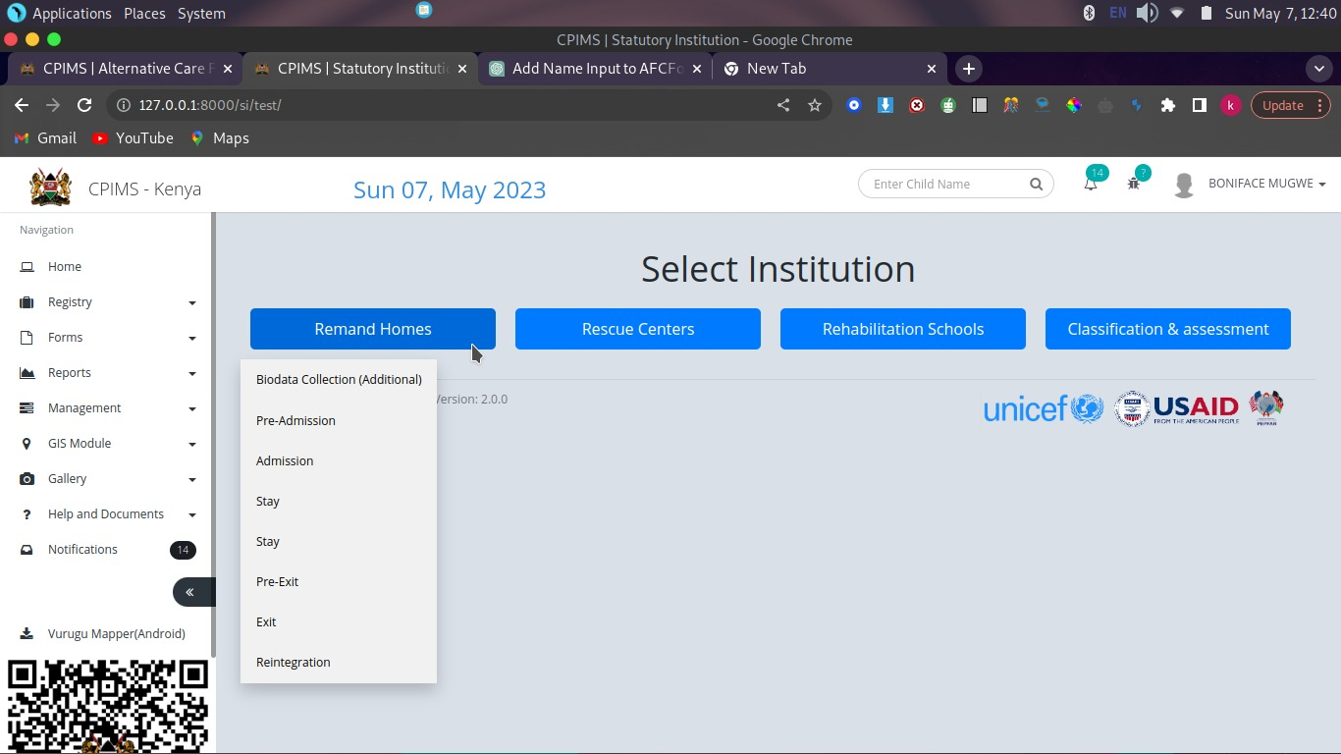
STATUTORY (SI) MODULES UI

Slide 7
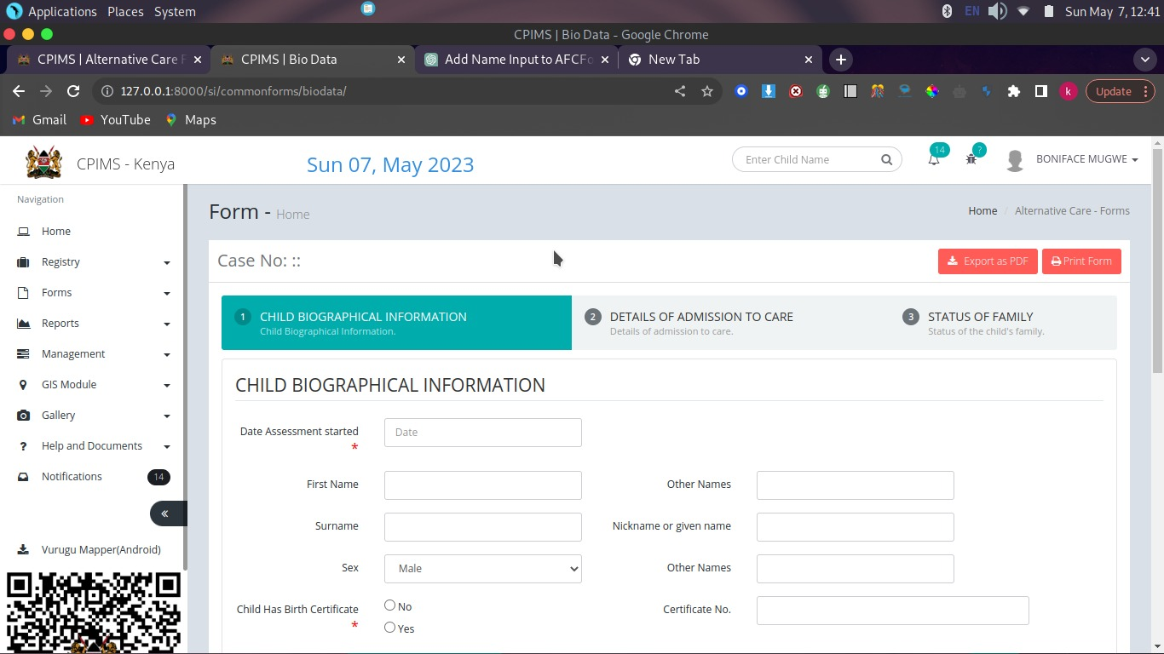
FORMS IMPLEMENTATION(EXAMPLE)

Slide 8
ACHIEVEMENTS
Successfully created and integrated the statutory module(SI) into the cpims system.
Successfully created, inherited relevant existing forms modules from the system and integrated them into the 4(SI)institutions.
successfully connected some the forms with the database to perform CRUD operations.

Slide 9
PROBLEMS ENCOUNTERED
Local system installation of the CPIMS system.
Stack challenges.
Poor internet connection.
Limited time.

Slide 10
CONCLUSION
Having interacted with the CPMIS system and having integrated some of our modules we were able to not only solve a problem but also learn from the entire Hackathon activity.
THE END

